Slide 1
Cochrane Library: Training Session for
Ohio Public Library Information Network
Ale Barciela,
Associate Director, Customer Training, Wiley
Barbara Jo Taylor,
Sr Customer Success Manager, Wiley

Slide 2
Barbara Jo (BJ) Taylor, Senior Customer Success Manager
I am your dedicated Customer Success Manager (CSM) who works alongside your Account Manager, to ensure you and your end users have the resources and support needed to gain the most value from your Wiley partnership. ​
​My job is to provide you personalized support and custom resources for the Wiley products your institution uses. I will work for you to discover innovative ways Wiley can support your researchers and your institution’s leaders. ​
​Please, consider me your day-to-day contact for any requests you have related to training, author workshops, usage reports, access, and ideas for how Wiley can support your institution’s strategic research priorities. ​
btaylor@wiley.com
Mobile: (908) 240-8465
Notes:
We established the Customer Success team to act as a Liaison for Account Managers, Support and Product
Conduit – representing them for the organization
Building processes w Support teams, communicating with the right teams
We’ll be able to work with new customers and set up a formal onboarding process and act as a long-term proactive contact to make sure you’re getting the most out of your investment
Close the gap between Account Managers and Customer Support
Partner with Account Managers communicate regularly – free them up to focus on responsibility, taking responsibility for triaging
Come up with proactive solutions, help them understand importance of certain requests and actions
Created operations team – part of Customer Success – sole job is to work with support to ensure experience is complete

Slide 3
Agenda
What’s Cochrane?
What’s in the Cochrane Library?
Key features
Live demo: Cochrane Library
Notes:
Today we will review what content is available on the Cochrane Library
Different ways of using the content
Main navigation of the site
New features and functionalities released in the last few months
Other things users may want to do in the site

Slide 4
What is Cochrane?
An international collaboration of over 50,000 researchers, health professionals, patients, carers, and people passionate about improving health outcomes for everyone, everywhere
Their overall objective is to ensure that the treatments used every day around the world, are based on the best possible knowledge, which is independently assessed and quality checked
They have been doing this for 25 years

Slide 5
What is the Cochrane Library?
A collection of databases that contain different types of high-quality, independent evidence to inform healthcare decision-making

Slide 6
What’s in the Cochrane Library?

Slide 7
What’s in the Cochrane Library
Cochrane Database of Systematic Reviews
+ 8200 Reviews
+ 2400 Protocols
Central Register of Controlled Trials (CENTRAL)
+ 1.7 million articles
Cochrane Clinical Answers (+2800)
Systematic Reviews from Epistemonikos (+350000)
Editorials (+130)
Special Collections (+40)
Health Systems Evidence (HSE) and Social Systems Evidence (SSE) created by McMaster’s University (+14000 and 4400)
NEW
Notes:
Different components in the library, which we will break down one by one in the next few slides:
Systematic reviews, comprising reviews and protocols
Main difference is that reviews will provide you with a solution or final conclusion related to your question or problem, whereas a protocol won’t provide you with a conclusion. Protocols are useful but won’t give you a conclusion if you are investigating a problem.
Trials
Clinical Answers
Systematic reviews from a new database, external, Epistemonikos, now accessible through the Cochrane library
Editorials and special collections

Slide 8
Cochrane Database of Systematic Reviews
Each review addresses a clearly formulated question e.g. Can antibiotics alleviate the symptoms of a sore throat?
Investigates the effects of interventions for prevention, treatment and rehabilitation in a healthcare setting.
Reviewed using stringent guidelines to establish whether or not there is conclusive evidence about a specific treatment.
Notes:
- A systematic review will indicate if there is a treatment available for a condition, based the best available evidence, based on the controlled trials.
- Objective is to look at the evidence and say if something is effective or not. One trial won’t provide enough evidence but all combined, using a population of over a thousand, they have statistical significance and can indicate if a treatment is effective or not.
- Trials are analysed and ranked, linked through the systematic reviews.

Slide 9
Cochrane Central Register of Controlled Trials
World’s largest database of Randomised Controlled Trials
Includes details of published articles taken direct from bibliographic databases and other published resources
The records include the title of the article, information on where it was published and in many cases, the abstract
The full text of these articles is not available as part of the Cochrane Library
How is CENTRAL created?
Notes:
In order to be comprehensive and independently review all the evidence, Cochrane Reviews must be supported by high quality searches and a comprehensive database of randomised controlled trials and controlled clinical trials (RCTs and CCTs).
Sourced by other databases like pubmed and Embase, public or privately sourced.
One spot, all collated and evaluated
Only content available is the abstract

Slide 10
Cochrane Central Register of Controlled Trials
Includes randomized and quasi-randomized controlled trials. Other study designs registered in Clinical Trial Registries (e.g. cohort studies) are not included.
CENTRAL is comprised of records retrieved from
PubMed/MEDLINE
Embase
Clinical Trial Registries
ClinicalTrials.gov
ICTRP
CINAHL (Cumulative Index of Nursing and Allied Health) (new as of May 2020)
Cochrane Review Groups' Specialized Registers which includes records identified by handsearching various biomedical sources.
Notes:
More info: https://www.cochranelibrary.com/central/central-creation

Slide 11
What is a Cochrane Clinical Answer?
A CCA provides a concise summary of the results of a Cochrane Review with sufficient underlying data to allow:
Application of the results to a specific patient group (e.g. children or adults, older patients with co-morbid conditions.)
Understanding of the strength of the evidence supporting conclusions about key clinical outcomes
Written by clinicians for clinicians
Make reviews more accessible to an important audience
Notes:
For the first time, integrated in the Cochrane Library
A CCA provides a concise summary of the results of a Cochrane Review with sufficient underlying data to allow:
- Application of the results to a specific patient group (e.g. children or adults, older patients with co-morbid conditions.) and
Understanding of the strength of the evidence supporting conclusions about key clinical outcomes.

Slide 12
Cochrane Clinical Answers
Clinical summaries on a question and answer format from Cochrane Reviews
Provide the evidence at hand on key outcomes
Make the information a clinician will be most interested in more accessible
Aim is to use information from Cochrane Reviews to inform healthcare decisions
Notes:
Q&A format
Actionable information
Most accessible component

Slide 13
How does a CCA ease application of results in clinical practice?
Distils the 50+ pages of a Cochrane review into 1-3 pages with interactive, hierarchical display allowing multiple levels of entry
Brings together key data dispersed in Cochrane Library Review:
Population
Intervention
Comparison
Outcome summary
Quality of the evidence (Summary of findings/Risk of bias)

Slide 14
Click to expand function allows you to view further information
Notes:
Question and Answer format.
Aim to keep the Answer under 250 words if possible but if it is longer, the Answer has a single bold take home message.

Slide 15
The Population, Intervention, Comparator section (PICO) at the bottom of the page describes people and interventions included in the trials to aid you in determining clinical relevance
Notes:
Click to expand function allows you to view further information
The Population, Intervention, Comparator section at the bottom of the page describes people and interventions included in the trials to aid you in determining clinical relevance

Slide 16
Quality of evidence (GRADE statements) or risk of bias analysis
A clear narrative statement
Statistical data on relative effects
A measure of absolute effects in terms of number of patients impacted out of 100 or 1000 (equivalent to NNT)
Link to forest plot
Link to the Cochrane Review on which the CCA is based
Notes:
Each expanded outcome includes further information from the original review:
Quality of evidence (GRADE statements) or risk of bias analysis
A clear narrative statement
Statistical data on relative effects
A measure of absolute effects in terms of number of patients impacted out of 100 or 1000 (equivalent to NNT)
Link to forest plot

Slide 17
Epistemonikos
World’s largest source of systematic reviews relevant for health decision-making
Uses a comprehensive and systematic approach, powered by artificial intelligence and curated and annotated by experts
+350,000 Reviews

Slide 19
What’s in the Cochrane Library
Cochrane Database of Systematic Reviews
Central Register of Controlled Trials (CENTRAL)
Cochrane Clinical Answers
Systematic Reviews from Epistemonikos
Editorials
Special Collections
Health Systems Evidence (HSE) and Social Systems Evidence (SSE) created by McMaster’s University
All content accessible through a single search

Slide 20
Cochrane Library: Key Features

Slide 21
Remember: access all content with a single search
Notes:
There is a question and Clinical Answer

Slide 22
Using filters to find relevant results

Slide 23
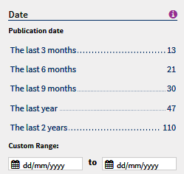
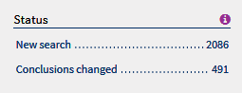
Filters specific for Cochrane Reviews
Date article was published online or added to the Cochrane Library
Status: Filters by events that have affected the review
Type: Used to identify the type of question addressed by the review

Slide 24
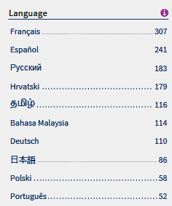
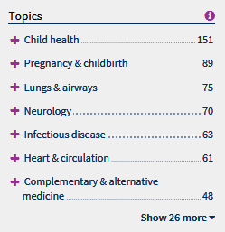
Filters for Cochrane Reviews
Language: Identifies when translations for content are available
Topic: Limit results based on Cochrane supplied topics

Slide 25
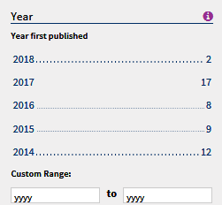
CENTRAL Filters
Date added to CENTRAL database
Publication year limit
Limits to articles sourced from PubMed, Embase, CT or WHO ICTRP

Slide 26
Many New Links between content
Cochrane Database of Systematic Reviews
CENTRAL
Article
References
How Cochrane Used this article
Characteristics of studies
Article
Cochrane Clinical Answers
Related Content
Cochrane Podcasts

Slide 27
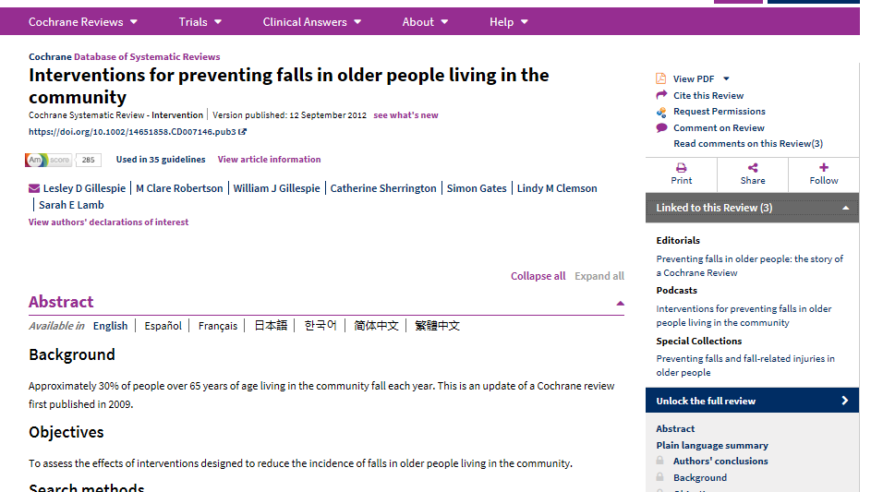
New links to find related Cochrane content and guidelines

Slide 28
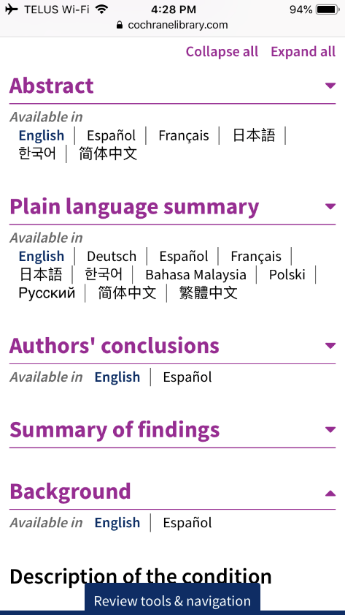
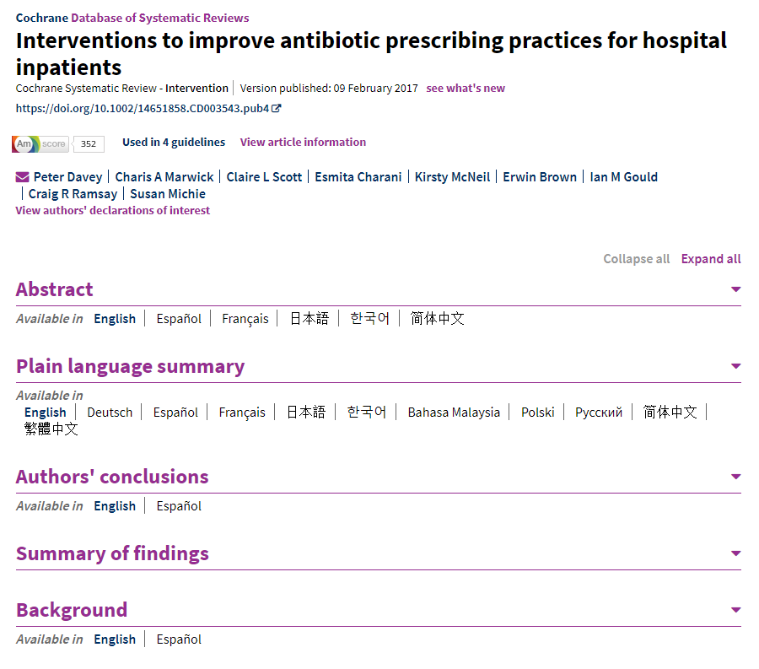
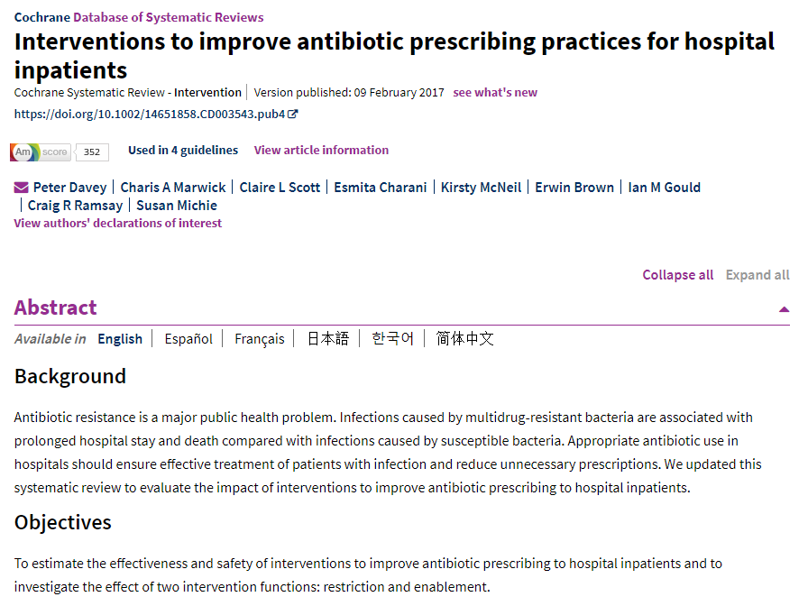
Navigation Update
Collapsible sections allows users to
Quickly navigate large reviews
Easily identify content with translations
Improves experience on mobile devices
Improved navigation on mobile devices

Slide 29
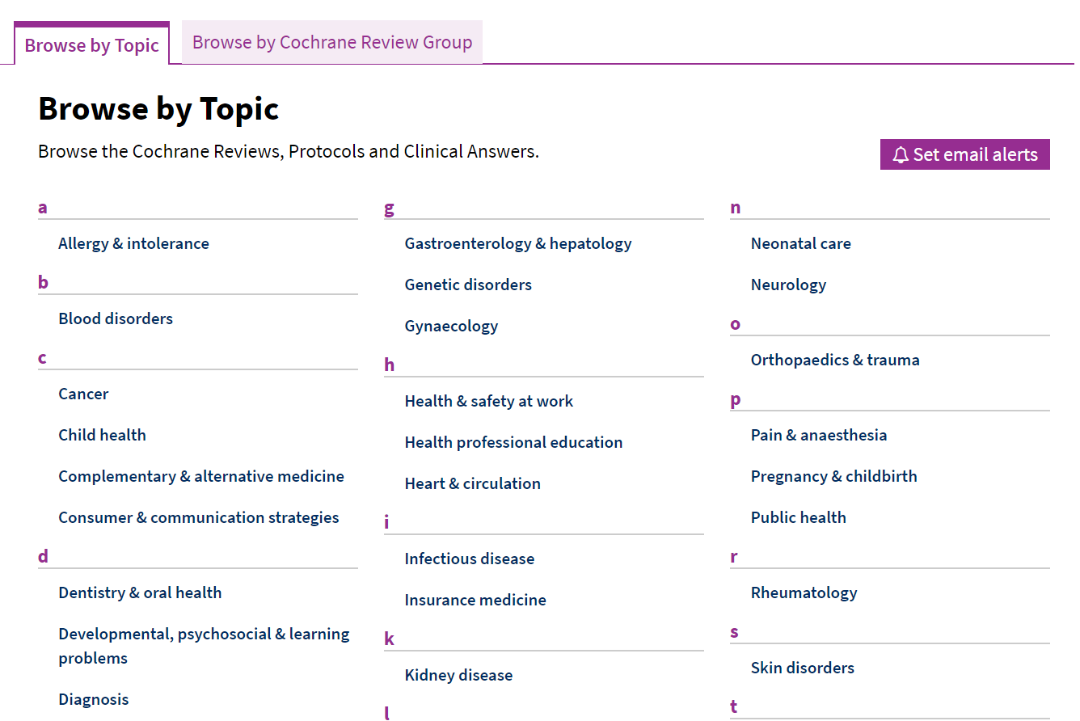
Email Alerts
Use Cochrane assigned topics to create alerts to monitor when new Cochrane Systematic Reviews on that topic are published

Slide 30
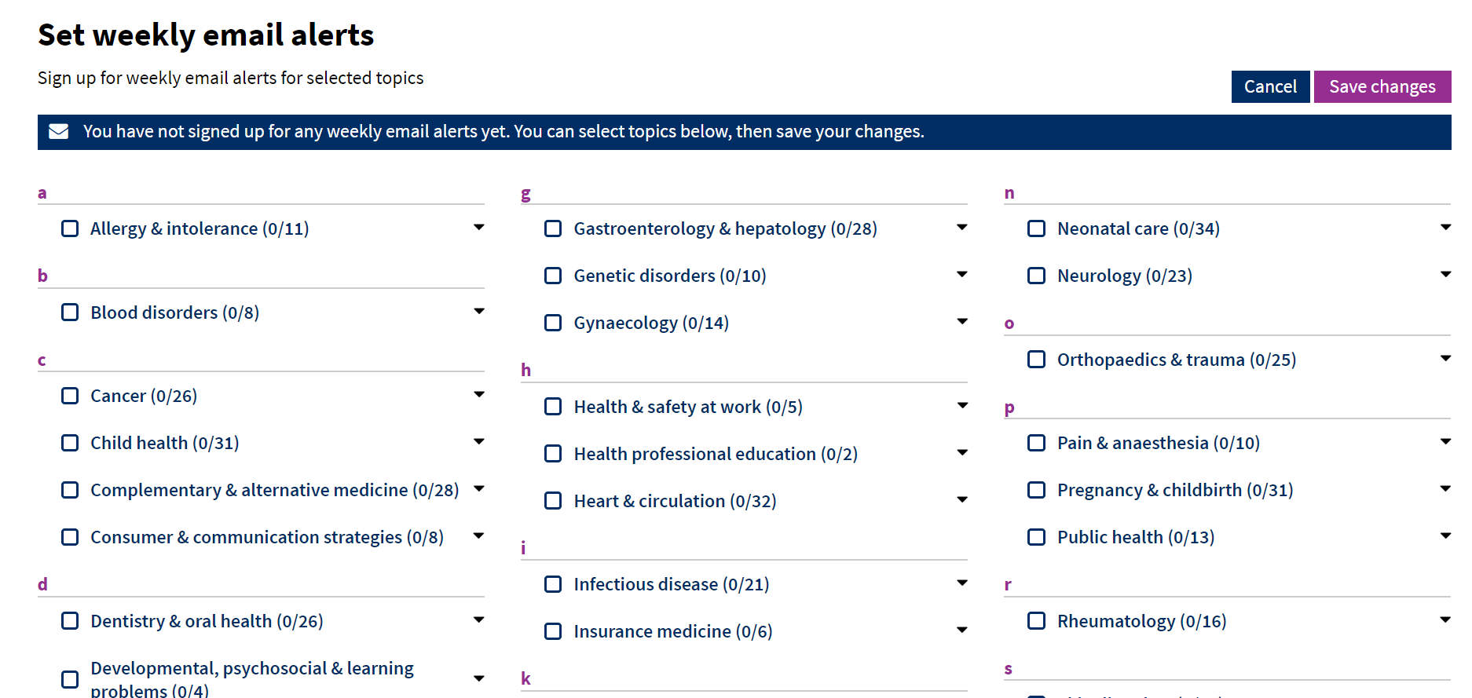
Email Alerts
Select as many fields as needed by checking the boxes

Slide 31
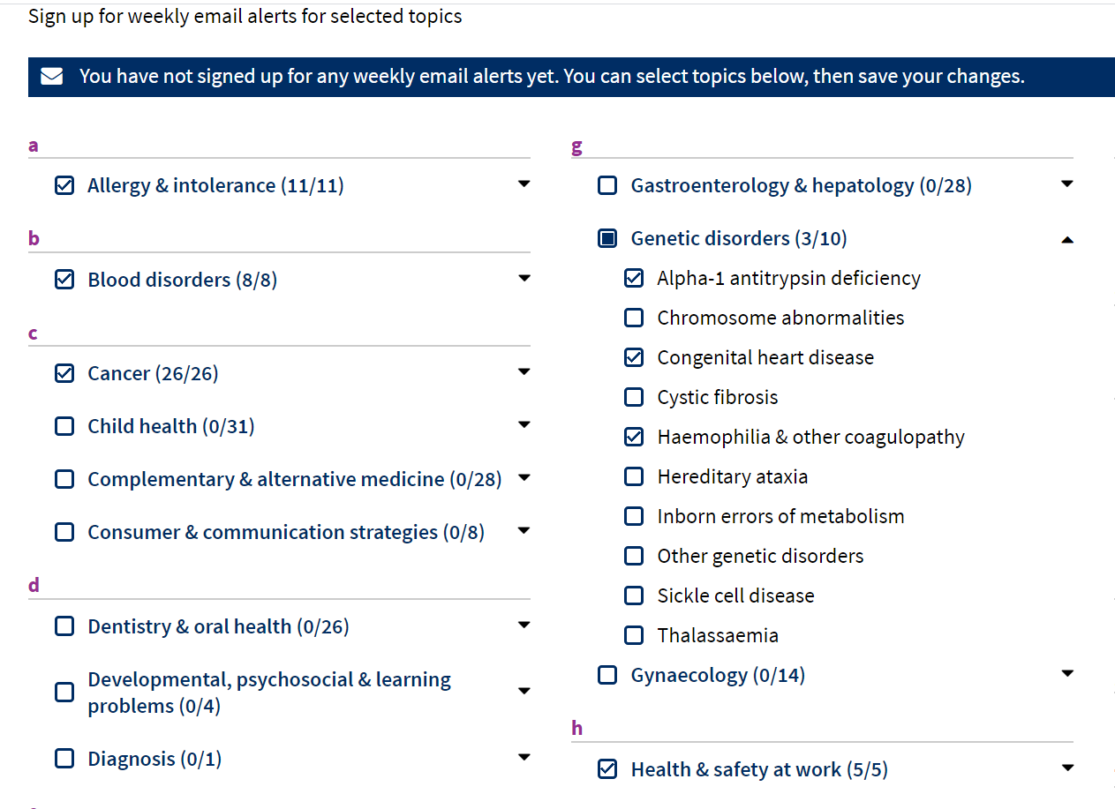
Email Alerts
Ability to select topics and subtopics by clicking the arrow

Slide 32
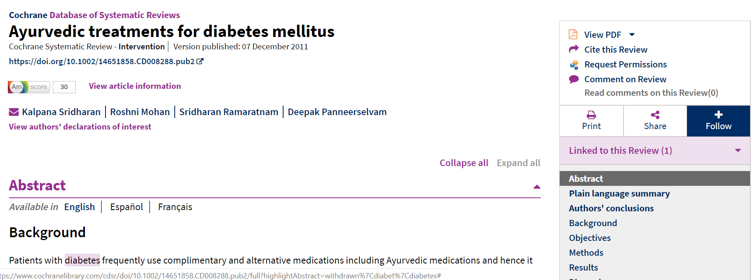
Following Reviews
Set up an alert to notify you when a specific systematic review is updated

Slide 33
Using the Cochrane Library: Live Demo

Slide 34
Summary: Search
Browse options for Cochrane Reviews
By Topic
By Cochrane Review Group
Search Options
Basic Search on Homepage
Search Tab
MeSH
Search Manager
PICO

Slide 35
Cochrane Library Homepage

Slide 36
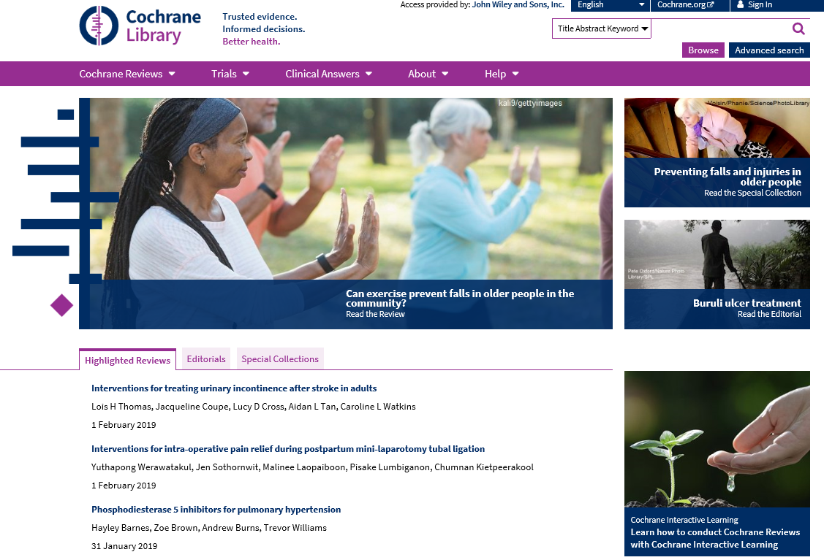
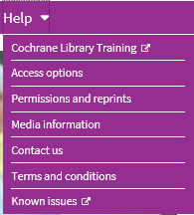
Getting help

Slide 37
Training hub
Search guides, live webinars, training videos, and more are available from the “Help” menu on the Cochrane Library homepage.
Register to more webinars here.

Slide 38
Thank you for listening! Questions? Barbara Jo Taylor btaylor@wiley.com Ale Barciela abarciela@wiley.com

